Slide 1

Express & MongoDB Workshop 2

Slide 2

Plan
Session 01:
Routing
Middlewares
SSR in ExpressJS
Session 02:
Databases & MongoDB
Cookies & Sessions

Slide 3
What’s a Database
A database is a collection of data that is organized in a way that enables efficient storage, retrieval, and management of that data.
A relational database is a type of database that stores data in tables with rows and columns. Each row represents a record or instance of data, while each column represents a specific attribute or field of that data.
A non-relational database, also known as a NoSQL database, is a type of database that does not use the traditional tabular schema used in relational databases.

Slide 4
What’s MongoDB
MongoDB is a popular document database that uses a document-oriented data model. In MongoDB, each document is stored as a JSON (JavaScript Object Notation) object, which can be nested and contain arrays and other complex data structures.
Mongoose is an Object-Document Mapping (ODM) library for Node.js that provides a way to interact with MongoDB databases using JavaScript.

Slide 5
Cookies & Sessions
Cookies and sessions are used to store data between requests in an HTTP application.
HTTP is a stateless protocol, which means that each request is independent of the others. And sometimes we need to maintain state between requests.
Cookie is a small piece of data that is stored on the client side
Session is a way to store data on the server side that is associated with a particular user.

Slide 6
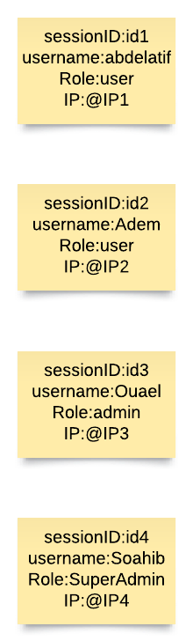
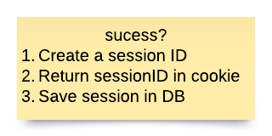


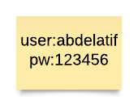
Cookies & Sessions
my.server.net/login
POST
set-cookie: SessionID=aiuhzeuts154qdytm

Slide 7
Cookies & Sessions
To use cookies and sessions in an ExpressJS application, you can use the cookie-parser and express-session middleware packages.
Cookie-parser parses cookies from incoming requests and makes them available in the "req.cookies" object
Express-session creates and manages sessions, and stores session data in a server-side store

Slide 8
Let’s try it out …

Slide 9
Thank for your attention
Any questions?

